Slide 1
發票工作管理下拉選單API

Slide 2
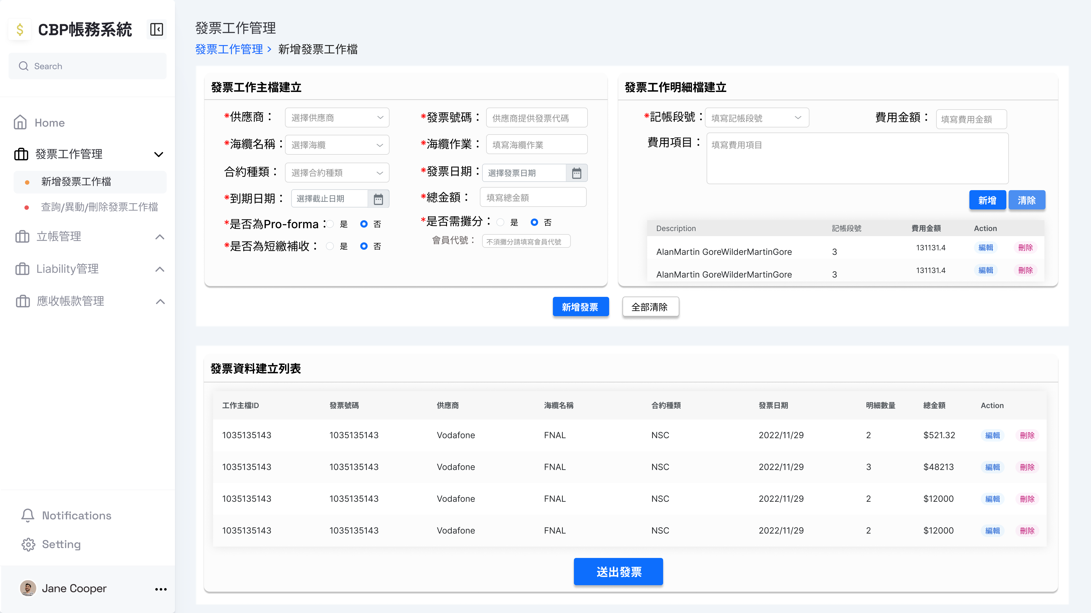
新增發票工作檔-供應商下拉選單
Response
[
{
"SupplierID": 2,
"SupplierName": "供應商名稱"
},
{...},
{...},
{...}
]
Method: GET
URL: http://127.0.0.1:8000/api/v1/Suppliers/all

Slide 3
新增發票工作檔-海纜名稱下拉選單
Response
[
{
"CableID": 1,
"CableName": "海纜名稱",
"Note": "筆記"
},
{...},
{...},
{...}
]
Method: GET
URL: http://127.0.0.1:8000/api/v1/SubmarineCables/all

Slide 4
新增發票工作檔-記帳段號下拉選單
Response
[
BillMilestoneName1,
BillMilestoneName2,
.
.
.
]
Method: GET
URL: http://127.0.0.1:8000/api/v1/BillMilestone/SubmarineCable=海纜名稱&WorkTitle=海纜作業

